Slide 1
Kartz
Advisor: Rebekah Michael
Created By:
Alex Mezcua (CS) – Developer
Chris Meyer – Lead Developer
Nicholas Ruth – Infrastructure/Security
Abele Abdi - Networking
Prayag Pandit – Database Administrator

Slide 2
Project Abstract
In 2020, over two billion people purchased goods or services online, and during the same year, e-retail sales surpassed 4.2 trillion U.S. dollars worldwide. Also, in the year of the pandemic, global retail e-commerce sales grew by more than 25 percent (E-commerce worldwide, 2022). Because of technical improvements and the ability to have most items delivered to their homes or ready for pickup promptly after purchase, millions of people use online shopping services. The issue with having so many online markets is that the end-user lacked the ability to organize their online purchased items. The Kartz application helped end-users by providing a location where they can keep track of their items organized in one place. The user can add, modify, and delete items in the items list using the application. Kartz has had an impact on the online shopping business by streamlining and organizing the process of online shopping.

Slide 3
Goals
The project we plan to create will help our audience by making online shopping more organized and manageable.
Users will be able to add, edit and delete items from their cart as well as mark items as something they already bought.
Users should be able to create an account and access that account.
Users should be able to remove account if necessary.
Users should have a unique account that only access their information.

Slide 4





Intellectual Merits
Interesting contributions to this project involve our use of Azure to hold our data and have the application deployed so our application will live in the cloud
The application uses a unique hashing algorithm called Bcrypt based off the blowfish cipher along with salting and stretching the hash for better security off the user's passwords
Axios is another interesting technology that is a JavaScript library used to make HTTP requests from node.js or XMLHttpRequests from the browser

Slide 5
Broader Impacts
This project has the potential to shop at multiple different websites at the same time. What this could do is save users time by making bulk purchases with a single payment instead of having to enter payment information at each individual website.
This project also will create a new tool that people can use for organization on desired purchases without having to keep track by manually accessing each website individually and looking at purchases etc.

Slide 6
Design Specifications
The system will be using React for the frontend, Python for the backend, and Azure for the database which will hold all information.
We are implementing a Model-view-ViewModel (MVVM) Architecture pattern.
Using a React Router for navigation across web pages.
Using Axios to access our API.

Slide 7
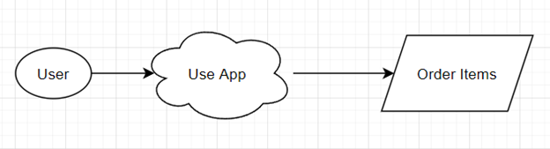
Design Diagram D0
In this diagram, the user; which is represented by an oval, is using the application to organize their desired online orders; which is represented by a parallelogram.

Slide 8

Design Diagram D1
This diagram goes into more detail than the 1st level. This diagram shows that the user will have to go through a process; which is represented by squares, of opening the app on a web browser in order to use the app. The user will then have to go through the process of finding and adding items from websites to order. Once they have the items they want to order, they can reach their goal of ordering the requested items.

Slide 9
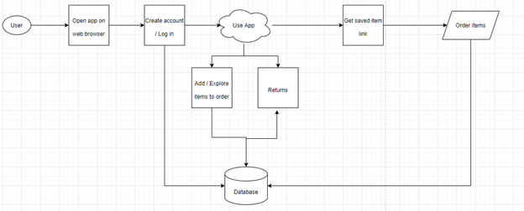
Design Diagram D2
This diagram goes into even more detail then both the 1st and 2nd level. This diagram shows that the user needs to go through the process of opening the app on a web browser. Then the user would have to do the process of creating an account for the app which will have the data stored into a database. Once the user has an account and is logged in, they will have to add an item they would like to order which will be stored into the database. Alternatively, the user will have the ability to select an item that is already in the app to order which will retrieve the URL associated with that item from the database. Once the user has the URL, they will be able to use this link to reach their goal of ordering their items. All ordered items will be stored into the database which will have a history of all purchased items. This opens the ability for the third option the user may take which is to return a previously purchased item which will have all the information retrieved from the database as well.

Slide 10
Technologies
Frontend: We work with ReactJS and CSS for displaying our webpages to the user.
Navigation is handled through a React Router.
Hooks handle live updates on the screen based on user input.
Axios is used for sending requests to our API.

Slide 11
Technologies
Backend: We are using Flask / Python for our backend.
Hashing passwords handled using an imported Bcrypt Library.
We have all our queries wrote into a file in the backend which is then sent with a tuple of inputs into the database.
The backend then returns a status code back to the frontend based on the results. (Ex. 200 for successful update to database).

Slide 12
Technologies
Database: Our database is hosted in the cloud with Azure, the application will pull the data such as the users, passwords, items etc... from the cloud.
The database is on a SQL server has a maximum size of 250 GB
Azure has the ability for us to scale the database to size so if the app is getting closer to the maximum storage, we can increase the amount of space

Slide 13
Milestones
Task | Task Name | Duration | Start Date | End Date
Establish application and development environments | Establish application | 1 week | 09/19/21 | 09/26/21
Record desired requirements/functionality | Requirements | 1 week | 09/19/21 | 09/26/21
Implement front end and backend environments | Implement flask and react environment | 2 weeks | 09/26/21 | 10/8/21
Develop and design database | Develop and design an SQL database using Microsoft Azure | 1 Week | 10/10/21 | 10/16/21
Implement list of items | Implement list of items as a flask component | 1 week | 10/17/21 | 10/23/21
Develop CRUD Operations | Develop Create, Update, and Delete functionality using flask and react. | 5 weeks | 10/17/21 | 11/15/21
Testing | Testing for final presentation | 1 week | 11/15/21 | 11/22/21(final presentation)

Slide 14
Milestones (cont.)
Task | Task Name | Duration | Start Date | End Date
Review and enhance project based on feedback from final presentation and review | Review feedback | 3 weeks | 12/3/21 | 12/24/21
Implement image functionality | Implement functionality to let user select an image for the item in the list | 6 weeks | 12/28/21 | 2/14/22
Implement and design Landing Page | Implement landing page for user sign up and sign in | 3 weeks | 1/16/22 | 2/05/22
Develop User access | Implement user access and sessions | 3 weeks | 1/16/22 | 2/05/22
Develop bought item functionality | Develop functionality to enable a user to label an item as bought | 1 week | 1/25/22 | 2/2/22
Design and implement history page | Design page to house items previously in cart | 1 week | 1/25/22 | 2/2/22

Slide 15
Milestones (cont.)
Task | Task Name | Duration | Start Date | End Date
Testing application for IT Expo | Testing/review | 2 weeks | 3/4/22 | 3/18/22
Finalize project | Finalize all features | 2 weeks | 3/19/22 | 4/3/22
Proofread paper | Paper maintenance | 1.5 weeks | 4/4/22 | 4/11/22
Prepare for IT expo | Expo prep | 3 days | 4/9/22 | 4/12/22

Slide 16
Demo

Slide 17
Results
Completed project scope, technical architecture diagram, user personas, use cases, use case diagrams, testing plan and unit test, and user stories,
Demonstrated prototype to Advisor. Worked with SQL ID auto increment to use in the database.
Completed testing review, budget, and UI.
Created Azure database that can scale and is accessible by each team member.
Working on implementing functionality such as information security, user access, user ability to implement a history page.
Will complete the deployment, signup page, log in functionalities, database connectivity, and backend and front-end functionalities.

Slide 18
Challenges
We had problems getting data from the database. Alex found out that the pyodbc module was not supported in some of the newer versions of Python. 3.9.6 and 3.9.7 seemed to work
We had a problem with incrementing item ids through SQL server. Chris originally had a workaround through the backend, but later implemented an Identity column through the server
We had issues getting all the data from the data object for a user's list. Chris found a way to map each item into a unique index then display that information back to the user.
We had an issue with navigation and separating our code without it being all tightly coupled. Alex found a way to separate the code and use a React router for navigation so that the URL would be unique to the page displayed.
We had an issue getting images without the user having to manually upload the image themself. Chris was able to find a way to pull images straight from Google Images based on the search result and return that to our application which the user could select which image they wanted to add.

Slide 19
Lessons Learned
Areas to improve on in future projects:
We could have had better code review and use of Pull requests but due to limitations we were unable to utilize this as much as we would have liked too.
Write unit tests earlier.
Stricter deadlines.

